Slide 1
3 Phase VFD For 750 W Induction Motor
VFD (Variable Frequency Drive)
Group # 1
Furqan Bari BSEE21005
Waqas Afzal BSEE21079

Slide 2
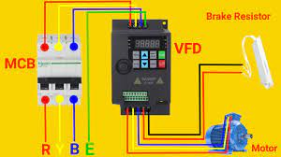
VFD?
A variable frequency drive (VFD) is a
type of motor controller that drives
an electric motor by varying the
frequency and voltage of its power
supply

Slide 3
Project Scope Components
Pumps
Fans
Compressors
Conveyors
Elevators
Extruders
As a Motor Starter
Used in pumps to control Flow
Electric Trains
Roller Coasters
555 IC
4060 IC
Tachometer
IRS2330 IC
MOSFETs
CMOS CD4035
CMOS CD4009
Resistors
Capacitors
Connecting wires
Diodes 1N448

Slide 4
Software Side
Proteous
Arduino
Current Progress
Get the basic understanding of the project.
Understand the flow of our project.
Get the software’s and controller used.
Finalize the type of hardware components to be used.
Learn the concepts related to projects like rectification and inverter

Slide 5
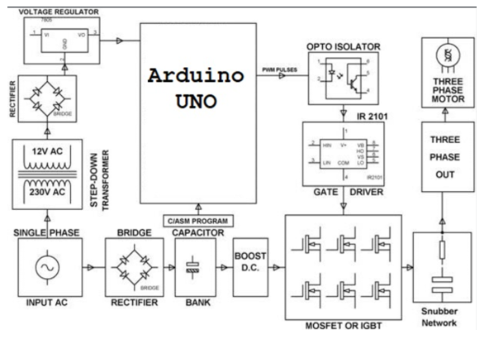
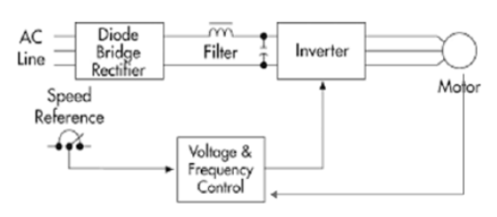
Project Flow

Slide 6
Conclusion
Need of this project
Before we controlled the speed of the motor using current and voltage (which give high starting torque, thus used high value of inverter 2-3 times rated motor).
This project controls the speed of 3-phase induction motor by controlling its frequency and also gives 0 starting torque. There basic flow also shown in adjacent block diagram. This is only for AC, where single phase do in and become Dc using rectifier and high power capacitor. Then it again convert to 3-phase Ac using IGBT/MOSFET with variable frequency which controlled by Arduino using concept of PWM modulation. Thus by this method speed of 3-phase 750W motor controlled.

Slide 7
Thank You

